Slide 1
Asp.net Overview
ASP.NET is the New version of Microsoft Web Technology for building powerful, dynamic and interactive Web applications .
Asp. Net is part of the .NET Framework".
ASP.NET is a server side scripting technology.
In ASP.NET scripts can be executed with in Web Server
ASP stands for Active Server Pages
Internet Information Service [IIS] is a web server for Asp.net Applications.
Common languages for writing ASP.NET applications are C# and VB.NET,Jscript..
Extension of Asp.net page is .aspx

Slide 2
Asp.net Overview
ASP 3.0 is the latest version of ASP, but there will never be an ASP 4.0 version.
ASP.NET is the next generation ASP, but it's not an upgraded version of ASP. ASP.NET is an entirely new paradigm for server-side ASP scripting.
ASP.NET comes with following versions
Asp.net 1.1,Asp.net 2.0,Asp.net 3.0,Asp.net 3.5,Asp.net 4.0
ASP.NET 3.5 is a major release of the product and is an integral part of the .NET Framework 3.5

Slide 3
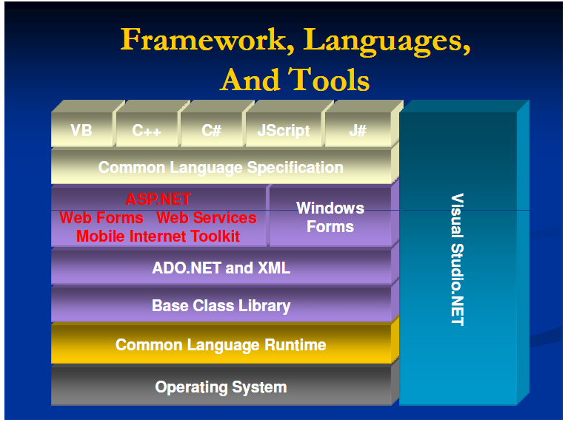

Slide 4
Asp.net Overview
Features of ASP.NET
Multiple Language Support.
Rich built in controls support
Event-driven programming
Data Source Controls
User authentication, with accounts and roles
Higher scalability
Session and Cache Enhancements
Masterpages
Increased performance - Compiled code
Easier configuration and deployment

Slide 5
Asp.net Overview
Asp.net Technology supports following app development.
Normal Dynamic websites
web services
Ajax web application[Asynchronous JavaScript and xml]
Silver light based applications
MVC web application[Model View Controller]

Slide 6
Asp.net Overview
Asp. Net Comes with Set of objects called asp.net intrinsic objects.
Response
Request
Server
Session
Application
Context
Trace

Slide 7
ASP.NET BLACK DIAGRAM
MVC,SILVERLIGHT,NEW CONTROLS
AJAX Integration
LINQ
WCF,WF
A
S
P
.
N
E
T
3.5
ASP.NET 3.0
A
S
P
.
N
E
T
4.0
MASTER PAGES
THEMES & SKIN
WEBPARTS
ASP.NET 2.0

Slide 8
Asp.net Overview
How Does ASP.NET Work?
When a browser requests an ASP.NET file, IIS passes the request to the ASP.NET engine on the server
The ASP.NET engine reads the file, line by line, and executes the scripts in the file
Finally, the ASP.NET file is returned to the browser as plain HTML

Slide 9
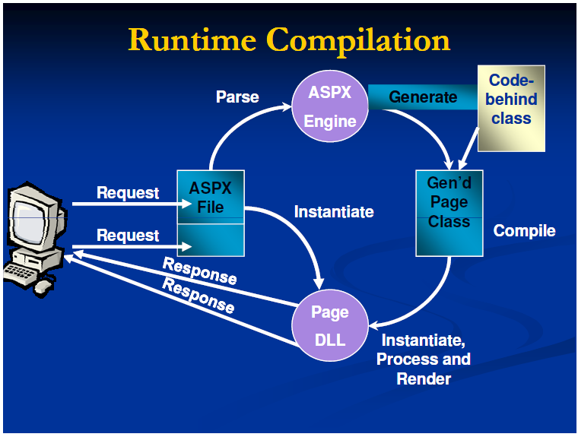

Slide 10
